Slide 1
Security Issues in Cloud Computing

Slide 2
Outline
Cloud Computing
Security Major Concern
Physical Layer Security
Network Level Security
Virtualization level Security
Management level Security
General Issues

Slide 3
Cloud Computing
Cloud computing providing unlimited infrastructure to store and execute customer data and program. As customers you do not need to own the infrastructure, they are merely accessing or renting, they can forego capital expenditure and consume resources as a service, paying instead for what they use.
Benefits of Cloud Computing :
Minimized Capital expenditure
Location and Device independence
Utilization and efficiency improvement
Very high Scalability
High Computing power

Slide 4



Security a major Concern
Security concerns arising because both customer data and program are residing in Provider Premises.
Security is always a major concern in Open System Architectures
Customer Data
Customer
Customer Code
Provider Premises

Slide 5
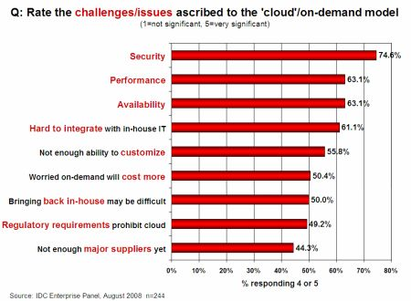
Security Is the Major Challenge

Slide 6
Dangers and Vulnerabilities
Security is to save data and program from danger and vulnerability
Dangers
Disrupts Services.
Theft of Information.
Loss of Privacy.
Damage information.
Vulnerabilities
Hostile Program.
Hostile people giving instructions to good programs.
Bad guys corrupting or eavesdropping on communications

Slide 7
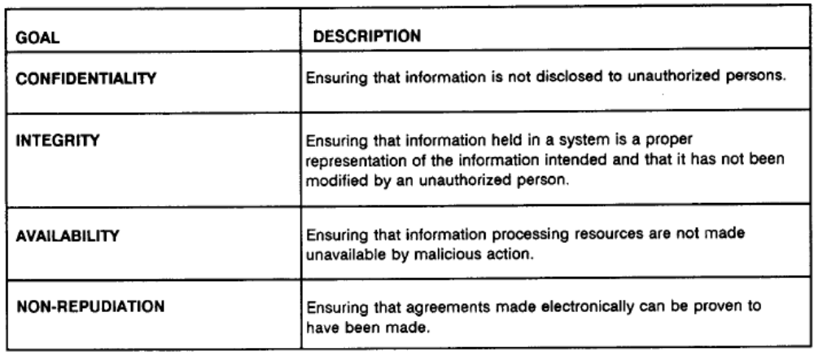
Common Security Requirements

Slide 8
Security at Different Levels
We need Security at following levels:
Server access security
Internet access security
Database access security
Data privacy security
Program access Security

Slide 9

Dealing with Network and Physical Layer!!!
Network Layer2(Host To Cloud)
Node X
Node Y
Physical Layer 1
Physical Layer 2
Network Layer 1(Within cloud)

Slide 10
Research Questions
At a Broad level,
Two major Questions are:
How much secure is the Data?
How much secure is the Code?

Slide 11
We need to answer following Questions…
What is Data Security at Physical Layer?
What is Data Security at Network Layer?
What about investigation Support?
How much safe is data from Natural disaster?
How much trusted is Encryption scheme of Service Provider?

Slide 12
How much safe is data from Natural disaster?
Data can be redundantly store in multiple physical location.
Physical location should be distributed across world.

Slide 13

Data centre Security?
Professional Security staff utilizing video surveillance, state of the art intrusion detection systems, and other electronic means.
When an employee no longer has a business need to access datacenter his privileges to access datacenter should be immediately revoked.
All physical and electronic access to data centers by employees should be logged and audited routinely.
Audit tools so that users can easily determine how their data is stored, protected, used, and verify policy enforcement.

Slide 14
Data Location
When user use the cloud, user probably won't know exactly where your data is hosted, what country it will be stored in?
Data should be stored and processed only in specific jurisdictions as define by user.
Provider should also make a contractual commitment to obey local privacy requirements on behalf of their customers,
Data-centered policies that are generated when a user provides personal or sensitive information, that travels with that information throughout its lifetime to ensure that the information is used only in accordance with the policy
Policies
Data

Slide 15
Backups of Data
Data store in database of provider should be redundantly store in multiple physical location.
Data that is generated during running of program on instances is all customer data and therefore provider should not perform backups.
Control of Administrator on Databases.

Slide 16
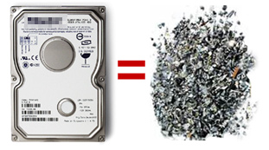
Data Sanitization
Sanitization is the process of removing sensitive information from a storage device.
What happens to data stored in a cloud computing environment once it has passed its user’s “use by date”
What data sanitization practices does the cloud computing service provider propose to implement for redundant and retiring data storage devices as and when these devices are retired or taken out of service.

Slide 17
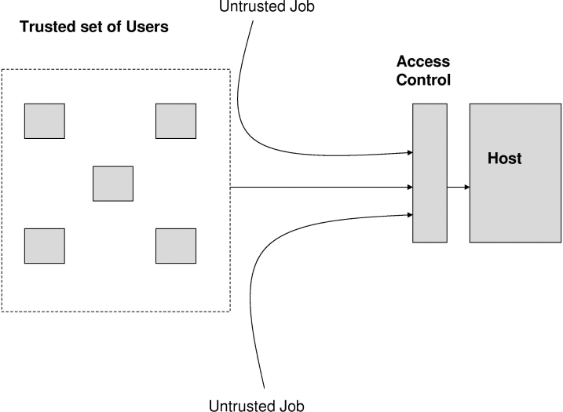
Host Security Issues
The host running the job, the job may well be a virus or a worm which can destroy the system
From malicious users
Solution: A trusted set of users is defined through the distribution of digital certification, passwords, keys etc. and then access control policies are defined to allow the trusted users to access the resources of the hosts.

Slide 18
Some virus and worm create--
Job Starvation Issue : where one job takes up a huge amount of resource resulting in a resource starvation for the other jobs.
Solutions:
Advanced reservations of resources
priority reduction

Slide 19
Information Security
Security related to the information exchanged between different hosts or between hosts and users.
This issues pertaining to secure communication, authentication, and issues concerning single sign on and delegation.
Secure communication issues include those security concerns that arise during the communication between two entities.
These include confidentiality and integrity issues. Confidentiality indicates that all data sent by users should be accessible to only “legitimate” receivers, and integrity indicates that all data received should only be sent/modified by “legitimate” senders.
Solution: public key encryption, X.509 certificates, and the Secure Sockets Layer (SSL) enables secure authentication and communication over computer networks.

Slide 20
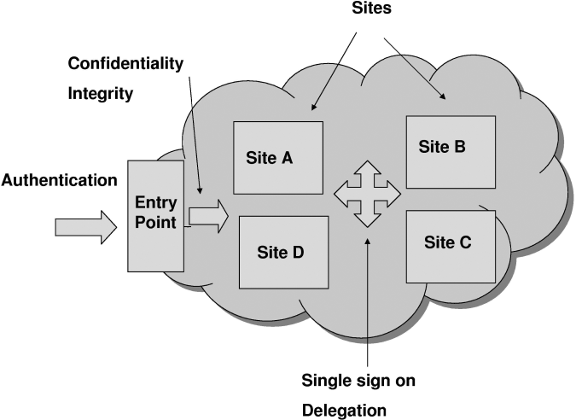

Slide 21
Network Security
Denial of Service: where servers and networks are brought down by a huge amount of network traffic and users are denied the access to a certain Internet based service.
Like DNS Hacking, Routing Table “Poisoning”, XDoS attacks
QoS Violation : through congestion, delaying or dropping packets, or through resource hacking.
Man in the Middle Attack: To overcome it always use SSL
IP Spoofing: Spoofing is the creation of TCP/IP packets using somebody else's IP address.
Solution: Infrastructure will not permit an instance to send traffic with a source IP or MAC address other than its own.

Slide 22
Port Scanning:
If the customer configures the security group to allow traffic from any source to a specific port, then that specific port will be vulnerable to a port scan.
When Port scanning is detected it should be stopped and blocked.
ARP Cache Attack: To find out the MAC address associated with a particular IP address, a computer simply sends an ARP request broadcast.
an attacker sitting on the same Ethernet network (i.e., LAN), can easily sniff the network traffic of a victim on his Ethernet network by sending spoofed ARP messages to the victim.

Slide 23
Security Issues from Virtualization
Type of virtualization provider is using- ParaVirtualization or full system virtualization.
Instance Isolation: ensuring that Different instances running on the same physical machine are isolated from each other.
Control of Administrator on Host O/s and Guest o/s.
Current VMMs do not offer perfect isolation: Many bugs have been found in all popular VMMs that allow to escape from VM!
Virtual machine monitor should be ‘root secure’, meaning that no level of privilege within the virtualized guest environment permits interference with the host system.

Slide 24
Vulnerability in Virtualization
Some vulnerabilities have been found in all virtualization software, which can be exploited by malicious, local users to bypass certain security restrictions or gain escalated privileges. For ex.
The vulnerability in Microsoft Virtual PC and Microsoft Virtual Server could allow a guest operating system user to run code on the host or another guest operating system.(Vulnerability in Virtual PC and Virtual Server Could Allow Elevation of Privilege )
A vulnerability was found in VMware's shared folders mechanism that grants users of a Guest system read and write access to any portion of the Host's file system including the system folder and other security-sensitive files.
A vulnerability in Xen is caused due to an input validation error in tools/pygrub/src/GrubConf.py. This can be exploited by "root" users of a guest domain to execute arbitrary commands in domain 0 via specially crafted entries in grub.conf when the guest system is booted.

Slide 25
Risk Prevention In VMM
VMM Should support following properties:
Isolation :Software running in a virtual machine cannot access or modify the software running in the VMM or in a separate VM.
Inspection: The VMM has access to all the state of a virtual machine: CPU state (e.g. registers), all memory, and all I/O device state such as the contents of storage devices and register state of I/O controllers. So that VMM can monitor VM.
Interposition: Fundamentally, VMMs need to interpose on certain virtual machine operations (e.g. executing privileged instructions). For ex. if the code running in the VM attempts to modify a given register.

Slide 26
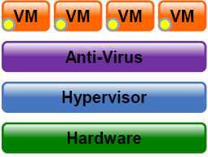
We need Anti –Virus layer to help control
and protect:
- Memory and CPU
- Networking
- Process execution control
- Storage

Slide 27
Management Related Issues:
Management is important as the cloud is heterogeneous in nature and may consist of multiple entities, components, users, domains, policies, and stake holders.
Credential Management:Credential management systems store and manage the credentials for a variety of systems and users can access them according to their needs.
Secure and safe storage of credentials is equally important.

Slide 28
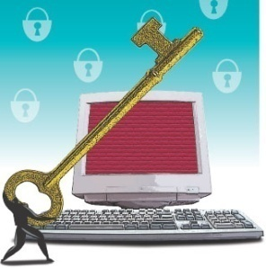
How secure is encryption Scheme
Is it possible for all of my data to be fully encrypted?
What algorithms are used?
Who holds, maintains and issues the keys?
Problem:
Encryption accidents can make data totally unusable.
Encryption can complicate availability
Solution
The cloud provider should provide evidence that encryption schemes were designed and tested by experienced specialists.

Slide 29
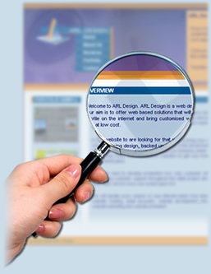
Investigative Support
Investigating inappropriate or illegal activity may be difficult in cloud computing because
-- logging and data for multiple customers may be co-located
-- may also be geographically spread across an ever-changing set of hosts and data centers.
Solution: get a contractual commitment to support specific forms of investigation, along with evidence that the vendor has already successfully supported such activities.

Slide 30

How to ensure Users that both
Data and Code are safe?
Very hard for the customer to actually verify the currently implemented security practices and initiatives of a cloud computing service provider because the customer generally has no access to the provider’s facility which can be comprised of multiple facilities spread around the globe.
Solution:
Provider should get some standard certificate from some governing or standardized institution that ensure users that provider has established adequate internal control and these control are operating efficiently.

Slide 31
Questions???

